Slide 1




Mini Project Presentation
Password Based Circuit Breaker
Himanshu Pandey | 1AT19EC071
Mainak Mitra | 1AT19EC093
Ajay Yadav | 1AT19EC073
Project Guide :
Prof. Rajagopalan Nadathur
Asst. Professor, Dept. of ECE, Atria IT,
Bangalore
Department of Electronics & Communication Engineering,
Atria Institute of Technology, Bangalore
Mini Project Presentation

Slide 2
Presentation Overview
Introduction
Literature review
Problem statement
Project overview with block diagram
Methodology and Design
Expected Outcome
Obtained output
Applications
References

Slide 3
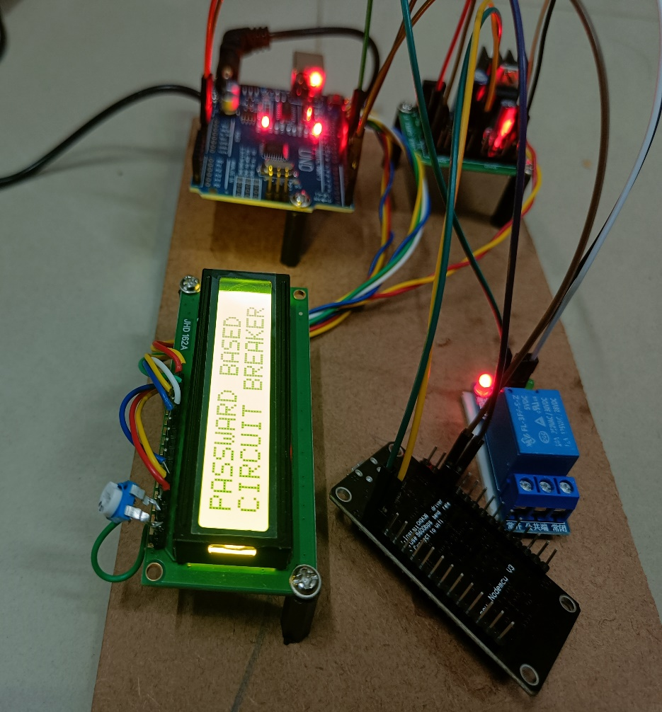
INTRODUCTION
We proposed our mini project on the Internet of Thing(I.O.T) based monitoring & control of circuit breaker.
It is an important component of Industrial Electrical Systems, and also it is used for protection & switching.
This project provide a password based circuit breaker system using IoT.

Slide 4
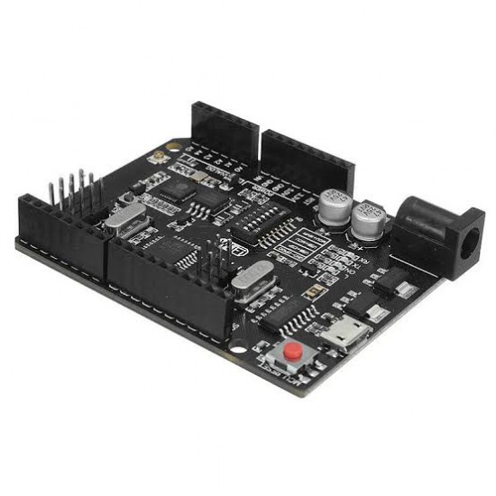
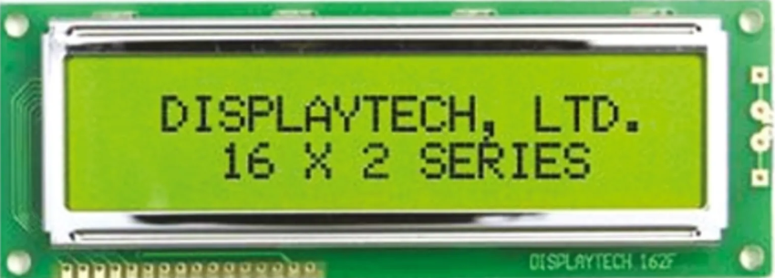
INTRODUCTION
This system uses a wi-fi module paired with Atmega-328p, microcontroller, and it also equipped with LCD display.
The proposed Electronic circuit breaker is based on the load current, typically a load value resistor.

Slide 5
Literature Review
Authors | Title, Contributions and Observations
Santosh Ashok Kamble, Jayashri Shrirang Bhagwat, Nilima Shrikrishna Bakde July 2020 IRJET | “IoT based circuit breaker.” It is designed to shut down a power supply when it is overloaded by using a super-fast electronic circuit breaker.
Abhijit Das, Dr. K. Kalimuthu, S.S. Biswas. 2018, International Journal of Applied Engineering Research IISN 0973-4562 Volume (IJAERV) | “IOT Based Circuit Breaker Monitoring & Control” It is eliminate the concern regarding security vulnerability of third party system as the platform is opensource.
B. Sai kumar, G. Vijay kumar, G. Sai Krishna, J.V.S. Nanda, M.V.S.S.R. Krishna Kanth, R. Sai Sunandh. 2018 Pramana Research Journal (PRJ) | “PASSWORD BASED CRICUIT BREAKER USING IoT” This project gives a solution to this problem to ensure line man safety. The relay ON/OFF operation will be indicated by the LED’s, also it sends a message to the receiver about the line disconnection. As soon as the maintenance work is finished then line man should enter the same password as used to disconnect the line earlier.

Slide 6
Problem Statement
Some of the operations of circuit breaker are:-
The password to operate can be changed and system can be operated efficiently with the changed password.
Write the program to the Password based Circuit Breaker in blink software and debug it.
Burn program to the controller with help of 8051 Programming Board.
Now give the connections as per the circuit diagram.
If entered password is correct, then the corresponding electrical line is turned ON or OFF.
The entered password is compared with stored password given in the ROM of microcontroller. If the given password is right, then only line can be switch ON/OFF. The circuit breaker activation/deactivation is indicated by lamp(ON/OFF).

Slide 7
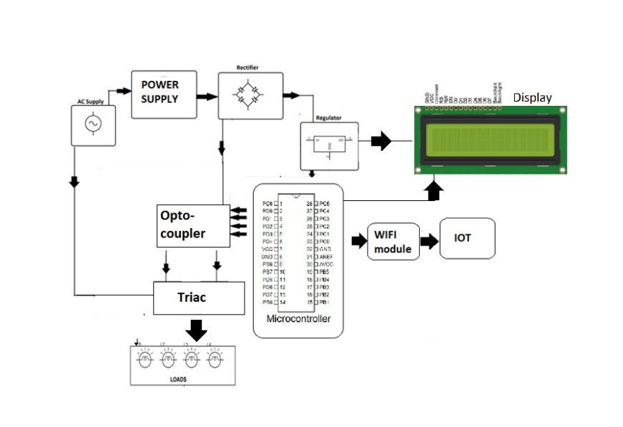
Proposed block diagram

Slide 8
Methodology and Design
Write the program to password based circuit breaker in ThinkSpeak
Debug the program to controller with the help of 8051 family.
5 operations are performed
Give the connection as per Circuit Diagram.
If password is correct, then the corresponding electrical line is turn ON or OFF
1
2
3
4
5

Slide 9
EXPECTED OUTCOMES OF THE PROJECT
In this way we are going to make circuit breaker smart and making its operation very reliable and makes its data available for all the users by using the internet of things.
By performing this project we can say that this project is used to operate the Electrical devices from very far distance. We can control the devices from any location of world just by sending SMS.
The maintenance time and downtime of the system reduces and also security of the system get increase.

Slide 10
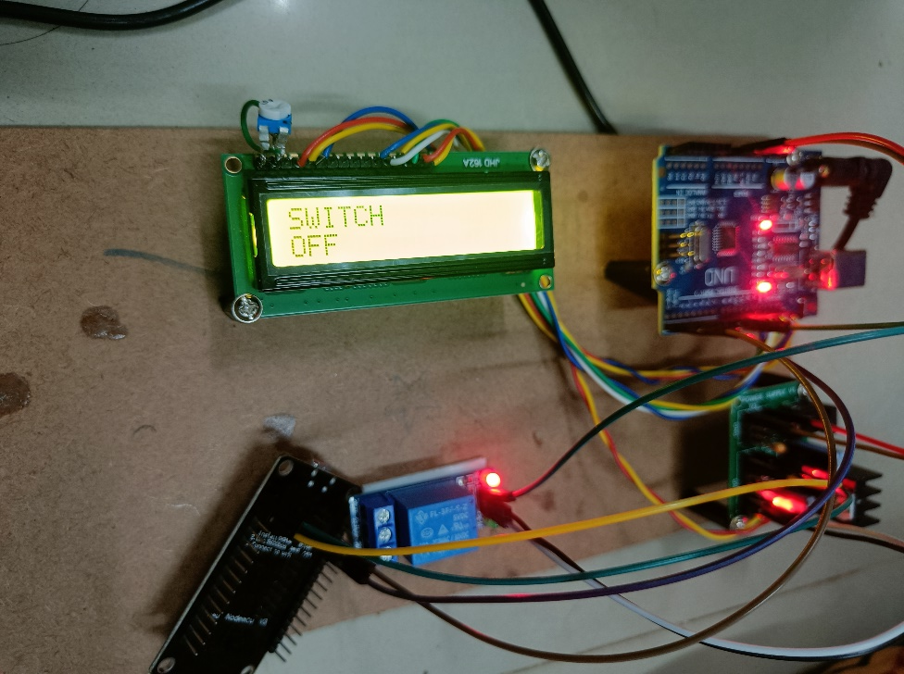
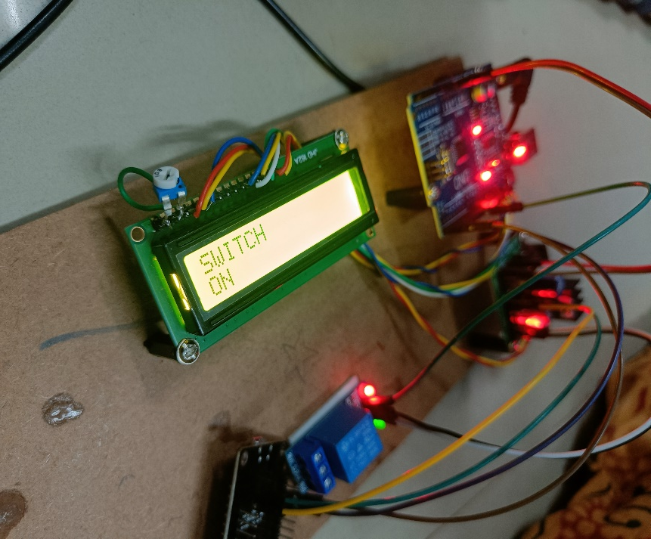
Obtained Output
Switch- Off
Switch- On

Slide 11
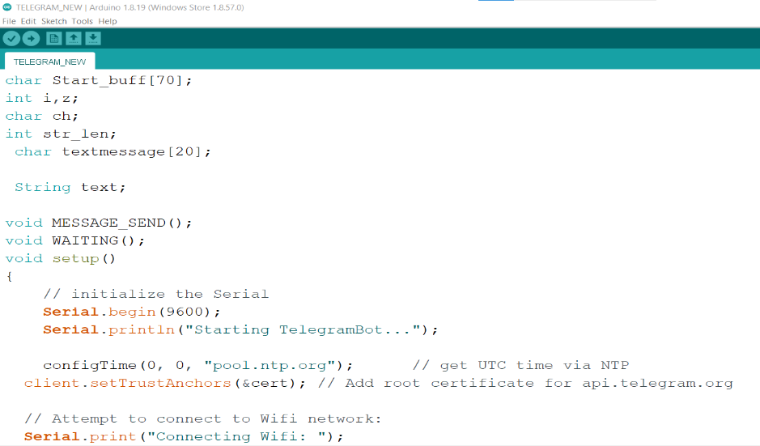
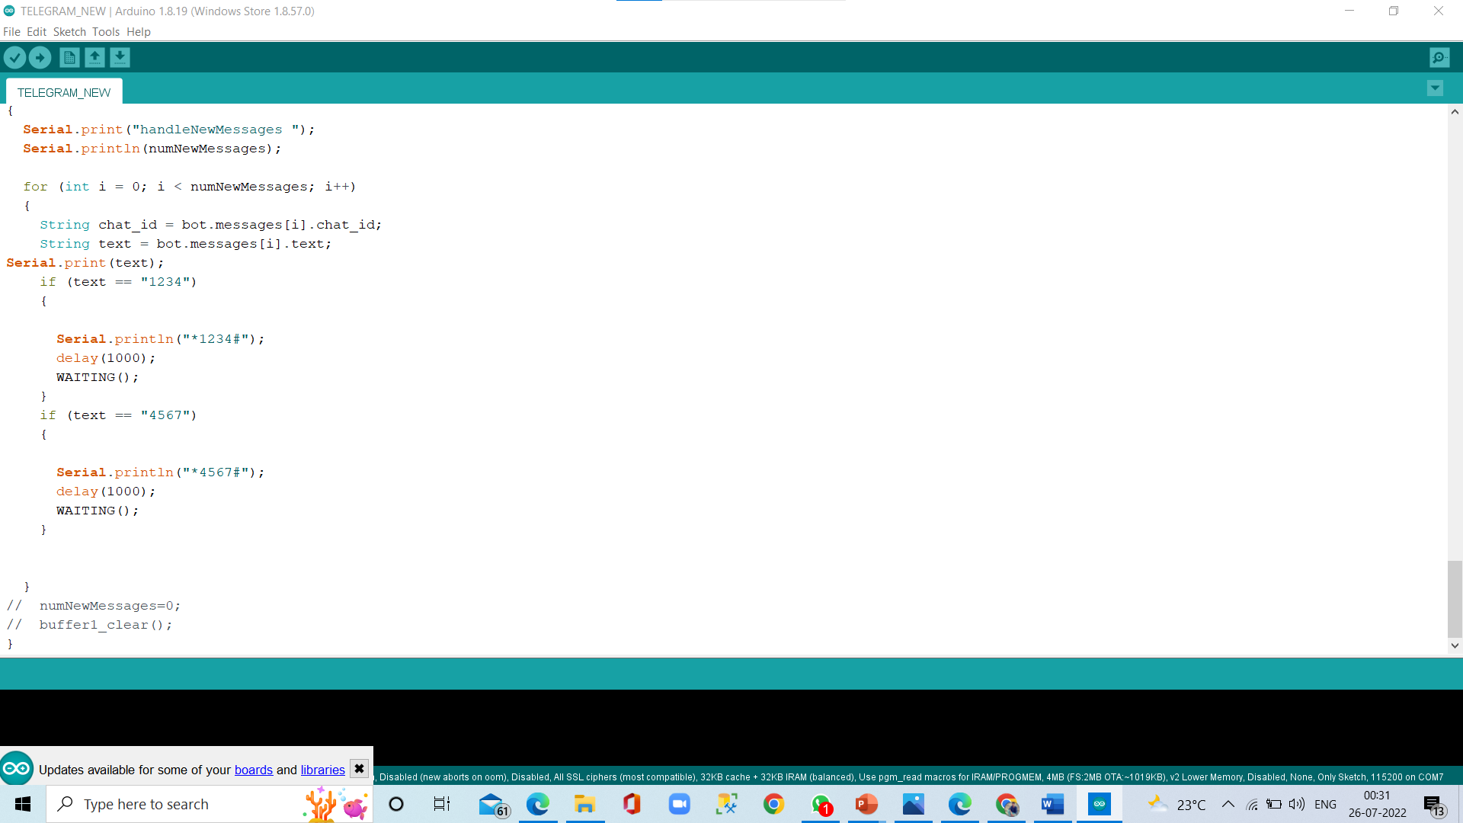

Obtained Output
Program

Slide 12
Applications
Some of the major fields in which Circuit Breaker is widely used are:-
Used in electrical substation to ensure line men safety
System is used in building and houses.
Used in hotels and shopping malls to save the power.
Can also be used as password based electrical appliance control or password based control system

Slide 13



RESULT

Slide 14
CONCLUSION
This system provides a solution, which can improve the safety of the project. It is designed to control a circuit breaker with the help of a password.
The maintenance staff e.g., Line man’s for control to turn ON/OFF. The line works with the line man only this system is arrangement such that a password is required to operate the circuit breaker (ON/OFF). Line man can turn off the supply and comfortably repair it, and return to the substation, then turn on the line by entering the correct or same password.
If the password entered is correct, then the line can be turned (ON/OFF).
Security is prime concern in our day-to-day life. Everyone wants to be more secure as to be possible. This system provides a new approach to a lineman security for their life. The circuit can be used without any fail of a lineman.

Slide 15
FUTURE SCOPE
The project can be interfaced with the GSM modem for the remote control of circuit breaker via SMS. So, the circuit breaker can, not only operate from the substation, but also from distance to wireless communication. SCADA can also be implemented to know where the fault occurred in the system directly and so a lineman can directly locate the fault location and can rectify it.

Slide 16
References
[1] Santosh Ashok Kamble, Jayashri Shrirang Bhagwat, Nilima Shrikrishna Bakde, “IoT based circuit breaker” July 2020 IRJET.
[2] Abhijit Das, Dr. K. Kalimuthu, S.S. Biswas. “IOT Based Circuit Breaker Monitoring & Control” IRJET 2018.
[3] B. Sai kumar, G. Vijay kumar, G. Sai Krishna, J.V.S. Nanda, M.V.S.S.R. Krishna Kanth, R. Sai Sunandh,“PASSWORD BASED CRICUIT BREAKER USING IoT”. 2018 Pramana Research Journal (PRJ).
[4] A M S Almadji & J G J Sloot review of Current limiting IEEE.

Slide 17
Thank You

